Slide 1
Angular 4
Day 1

Slide 2
Day 1 Agenda
Single Page Applications
Why Angular 4
Angular 4 – Features
Angular 2 Vs Angular 4
Hello world Application
Build a Reddit Application
TypeScript
Built-In Directives
Build a Product Application
Directives

Slide 3






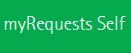
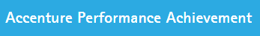
Single Page Applications
A single-page application (SPA), also known as single-page interface (SPI), is a web application or web site that fits on a single web page with the goal of providing a more fluid user experience akin to a desktop application.
Benefits -
Great user experience (speed)
Runs on any device
Can work offline
App-store deployable

Slide 4
Single Page Applications
Angular is a framework that is used to create Single Page Applications.

Slide 5
Why Angular 4
Angular 1 is popular and used by many developers
Angular 2 improved Angular 1’s functionality and made it more
Faster
Powerful
Clean
Easy
scalable
Performance and Mobile
Angular 4 is compatible with Angular 2

Slide 6
Angular 2 and 4 Features
Speed & Performance
Code Generation
Code Splitting
Develop Across All Platforms - For web, mobile web, native mobile and native desktop.
Progressive Web Apps
Native (Ionic, NativeScript, ReactNative)
Desktop Installed
Productivity
Templates
Angular CLI

Slide 7
Angular 2 and 4 Features
Ability to build a Form which monitors the users input as well as submit without monitoring the changes
Angular's templates are authored using semantic HTML, encouraging a strong separation between how a component is structured and how it behaves
Enhanced Routing with more features
Annotation based
Using Observables- More advantages over Promises Observables are cancellable and retry option can be implemented easily.
Shadow DOM - Part of the Web Components spec as proposed by W3C, which basically allows the encapsulation of smaller DOM elements and CSS styles into a single DOM element
Notes:
http://angularjs.blogspot.in/2016/03/why-angular-renders-components-with.html
So by using Shadow DOM, we're able to hide the implementation details of our web element, and only pass along necessary information to the sub-elements (i.e. height, width).

Slide 8
Angular 4 – Building Blocks
Components
Encapsulates the template, data and behaviour of the view
Directives
Angular HTML extensions that allows DOM manipulation
Services
Encapsulates non user interface logic
Routers
Handles navigation requests
Modules
Angular Modules help organize an application into cohesive blocks of functionality.

Slide 9
Angular 1 Vs Angular 2
Key Differences
Angular Modules
Components
Data Binding
Removal of many directives
Structural Directives
Services
Dependency Injection
TypeScript is a Superset of ES6/ES2015+
40+ Built-In Directives Removed
Bind to any HTML Element Property or Event
Angular 1 Concepts Map to Angular 2

Slide 10
Angular 4 Vs Angular 2
Smaller and Faster
TypeScript 2.1+ is required. Earlier it was 1.8
Angular 4 supports strictNullChecks of TypeScript Option.
Ahead of Time Compilation – View Engine (Big Change)
In AoT mode, Angular compiles your templates during the build, and generates JavaScript code.
A new view engine produces the less code with AOT compilation
from 499Kb to 187Kb (68Kb to 34Kb after gzip)
from 192Kb to 82Kb (27Kb to 16Kb after gzip)
Notes:
Noted:- AoT has several advantages: it errors if one of your templates is incorrect at build time instead of having to wait at runtime, and the application starts faster (as the code generation is already done). You also don’t have to ship the Angular compiler to your users, so, in theory, the package size should be smaller. In theory, because the downside is that the generated JS is generally bigger than the uncompiled HTML templates. So, in the vast majority of applications, the package is in fact bigger with AoT.

Slide 11
Angular 4 Vs Angular 2
Universal
Starting with this release, Universal project which allows to do server-side rendering is an official Angular project
Animations
Animations now have their own package @angular/platform-browser/animations
Templates
template is now ng-template
ngIf with else
Notes:
Animations
This means the bundle you ship to your users will not include useless code if you don’t use animations in your app.

Slide 12
Angular 4 Vs Angular 2
Pipes
titlecase
http
Adding search parameters to an HTTP request has been simplified
Forms
Validators - New validator email is included.
Compare select options - A new directive has been added to help you compare options from a select: compareWith

Slide 13
Angular 4 Vs Angular 2
Router
ParamMap A new interface has been introduced to represent the parameters of a URL: ParamMap.
The CanDeactivate interface now has an extra (optional) parameter, containing the next state (where you are going to navigate).
Packaging changes
Flat ES modules

Slide 14
TypeScript

Slide 15
TypeScript
Angular 2 is built on top of TypeScript (1.8) and Angular 4 (TypeScript 2.1)
Enhanced feature of Typescript 2.1 and above
Mapped types and more
Refer for more details
TypeScript
-types
-annotations
ES6
-classes
-modules
ES5

Slide 16

TypeScript
Transpilers or Transcompilers are used to convert TypeScript to ES5 Code.
Traceur by Google and Babel by JavaScript community is used to convert ES6 to ES5 Code
TypeScript is an official collaboration between Google and Microsoft.
TypeScript
JS

Slide 17
TypeScript – Improvements over ES5
Types
Classes
Annotations
Imports
Language Utilities (Destructuring)
Notes:
Improv

Slide 18


Types
Declaring variable
Declaring function
Use the command to compile TypeScript
tsc hello.js
Install tsun for TypeScript REPL

Slide 19
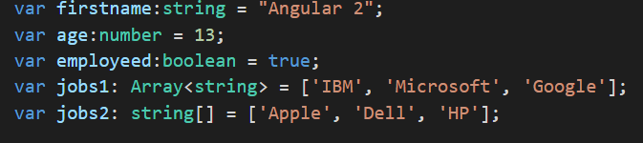

Built-In Types
string
number
boolean
Array
void
any

Slide 20




Built-In Types
enum
Values 0, 1, 2
Values 3, 4, 5
Values 3, 5, 7
logs 0, 1, and 2

Slide 21
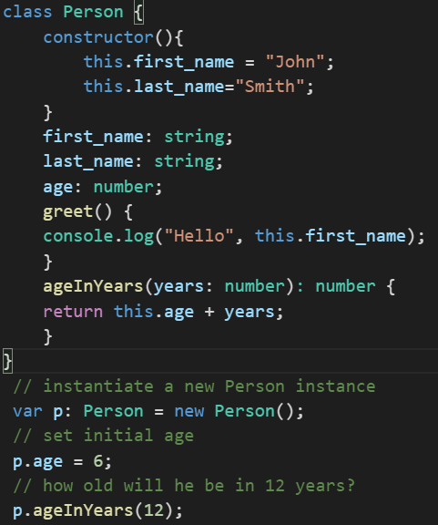
classes
Only one constructor is allowed in TypeScript

Slide 22
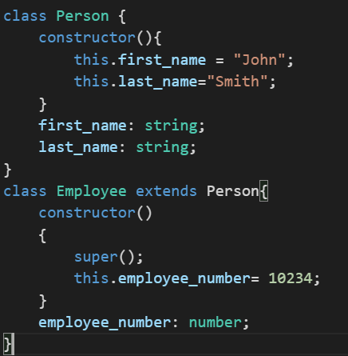
Inheritance
Notes:
Use super to call the super class constructor and functions.

Slide 23
Utilities
Fat Arrow Functions
Fat arrow => functions are a shorthand notation for writing functions.
One important feature of the => syntax is that it shares the same this as the surrounding code.
This is important and different than what happens when you normally create a function in Javascript , that function creates its own this.

Slide 24
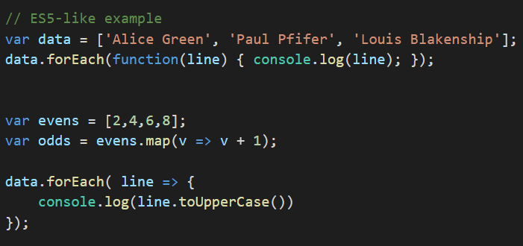
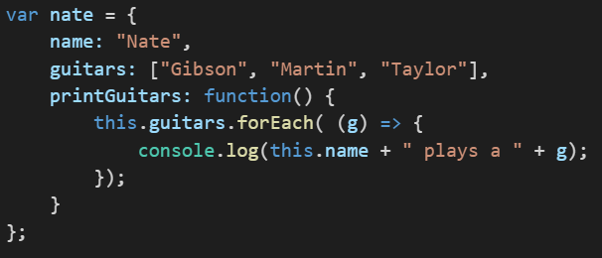
Utilities
Fat Arrow Functions

Slide 25
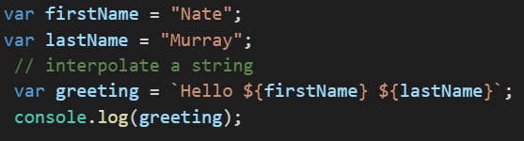
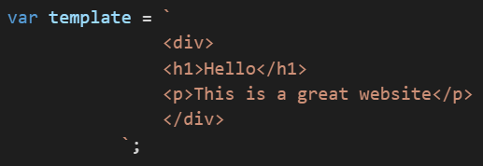
Template Strings
Variables within strings (without being forced to concatenate with +) and
Multi-line strings

Slide 26
Modules
ECMAScript 2015 supports the concept of modules
Modules are executed within their own scope, not in the global scope.
Variables, functions, classes, etc. declared in a module are not visible outside the module unless they are explicitly exported using export .
In order to consume a variable, function, class, interface, etc. exported from a different module, it has to be imported using of the import.
Modules are declarative; the relationships between modules are specified in terms of imports and exports at the file level.

Slide 27
Other features of TypeScript
Interfaces
Generics
Importing and Exporting Modules
Annotations
Destructuring
Demo
Notes:
Show the demo programs from Typescript 01-01 using the online editor - http://www.typescriptlang.org/play/

Slide 28
Hello world Application
Notes:
Show a HellowWorld Angular 2 program in a plunkr. For a development environments, Angular Cli or anything similar is preferred

Slide 29
Bare minimal Angular Application
app/app.component.ts - this is where we define our root component
app/app.module.ts - the entry Angular Module to be bootstrapped
index.html - this is the page the component will be rendered in
app/main.ts - is the glue that combines the component and page together

Slide 30
Bare minimal Angular Application - NgModule
Components are not created directly but create an NgModule that points to the component to load.
@NgModule has three keys
declarations
Specifies the components defined in the module.
imports
Dependencies on this module (BrowserModule)
bootstrap
Tells angular which component is to be loaded as Top-level component.
Notes:
When we create the component using ngGenerate , the declarations are automatically added to this section

Slide 31

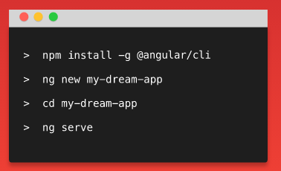
Angular Cli
The Angular CLI is a tool to initialize, develop, scaffold and maintain Angular applications.
easy to create an application that already works, right out of the box. It already follows our best practices!
Generate components, routes, services and pipes with a simple command. The CLI will also create simple test shells for all of these.
Easily test your app locally while developing.
Make your code really shine. Run your unittests or your end-to-end tests with the breeze of a command.

Slide 32
Angular Cli
Scaffold | Usage
Component | ng g component my-new-component
Directive | ng g directive my-new-directive
Pipe | ng g pipe my-new-pipe
Service | ng g service my-new-service
Class | ng g class my-new-class
Guard | ng g guard my-new-guard
Interface | ng g interface my-new-interface
Enum | ng g enum my-new-enum
Module | ng g module my-module

Slide 33
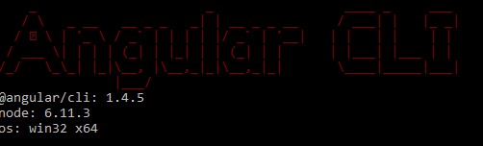
DEMO
Getting Typescript
First install node.js from the website and get TypeScript using the following command
>npm install –g typescript
Install Angular cli
>npm install –g @angular-cli
$ ng new angular4_hello_world.
$ ng -v
You get the message “Installing..” Wait to see the message “Installed
Open using VS Code –see only the needed one
$ ng serve
http://localhost:4200
Notes:
Comment out
imports: [ BrowserModule //FormsModule, //HttpModule ]
And show BrowserModule is mandatory.

Slide 34
Component
Newer version of Angular 1 directives.
$ ng generate component hello_world
This generates a component and can be used in html like
<app-hello-world></app-hello-world>
Unlike Angular 1 where all the directives are globals, you must specify the components used.
Every component must be declared in one NgModule before it can be used in a template.
Demo
Notes:
Add the following line to app.component.html within the h1 tag.
<app-hello-world></app-hello-world>

Slide 35
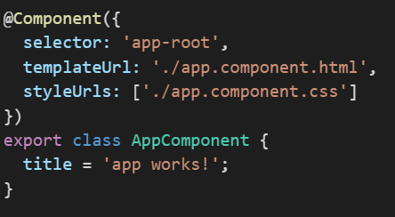

Component
Components are the fundamental building blocks of Angular 2
Composed of three parts
Component Annotation
A view – template or templateUrl
A Controller
Tells Angular what element to match

Slide 36
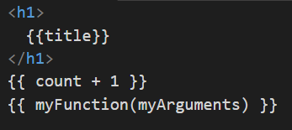
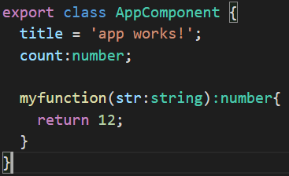
Template Binding
Template binding is achieved using {{}}
Maps to the values from the component class

Slide 37


Data Binding
{{expression}}
Interpolation
[property]=“expression”
One way binding
(event)=“statement”
Event binding
[(ngModel)]
Two way Binding

Slide 38
Data Binding
Expressions Restrictions
Cannot use Assignments like =, +=, ++ etc.
Cannot use new keyword to create new objects
Cannot chain the expressions using ;
Cannot access anything on the global namespace like console, windows etc
Expression Recommendations
No Side-Effects
Expressions should be Fast
Should be simple - less business rules
Idempotent - All the time returns the same result for a given input

Slide 39
Data Binding
Statement Restrictions
Can use Assignments only =, ( +=, ++ etc. )
Cannot use new keyword to create new objects
Can chain the expressions using ;
Statement Recommendations
No Side-Effects
Expressions should be Fast
Should be simple - less business rules
Idempotent - All the time returns the same result for a given input
statements can refer only to what's in the statement context such as an event handling method of the component instance.

Slide 40
Data Binding
Angular 2’s change detection is based on unidirectional data flow.
Easier Widget Integration
No more $apply
No more repeated digest cycles
No more watchers
No more performance issues with digest cycle and watcher limits

Slide 41
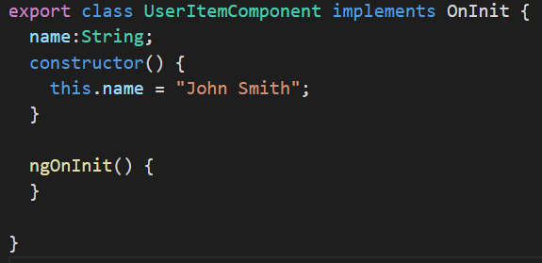
Adding Data to the Component
$ ng generate component user_item
To Show the name of the particular user
Add the name in the component’s constructor
Demo
Notes:
Add the following line to app.component.html within the h1 tag.
<app-user-item></app-user-item>

Slide 42
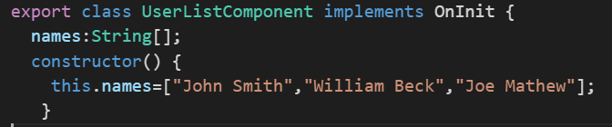
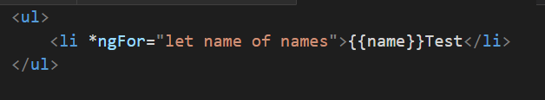
Working with Arrays
Create a new component with a string array to the component class.
Use in the template component
Demo
Notes:
Change the name in the above example to “p’ and change in the {{}} as well
Changing the value of names will not fetch any data.

Slide 43
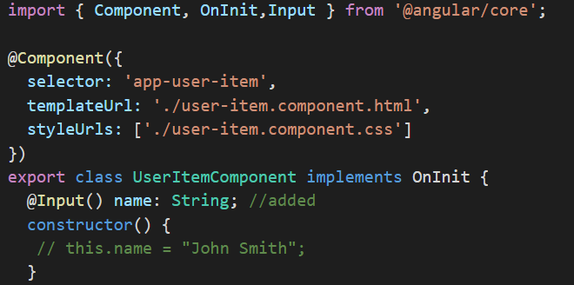
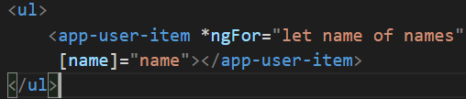
Accepting Inputs
@Input allows to pass an input value from a parent template
Demo

Slide 44
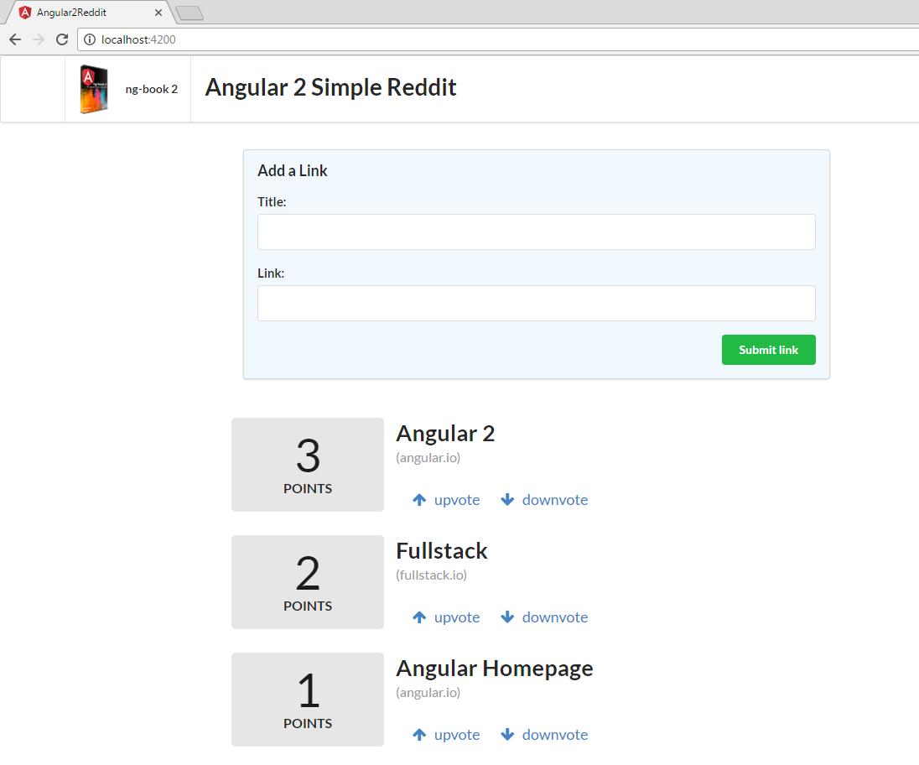
Build a Reddit Application
Application
Article
Article
Article
Notes:
Follow the instructions in the handout and develop the Reddit application. The completed code is under demos- Reddit 01-02.

Slide 45
Built-in directives

Slide 46
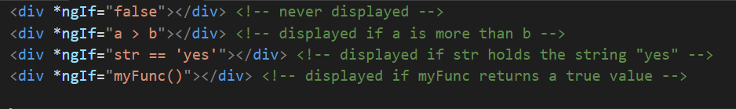
NgIf
The ngIf directive is used when you want to display or hide an element based on a condition.
The condition is determined by the result of the expression that you pass into the directive.
Notes:
The built-in directives are imported and made available to your components automatically,
so you don’t need to inject them as a directive like you would do with your own
components.

Slide 47
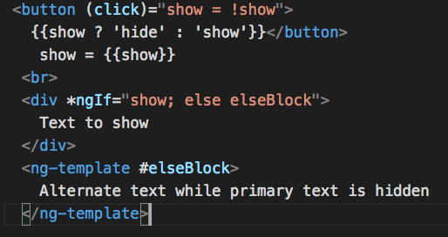
NgIf - else

Slide 48
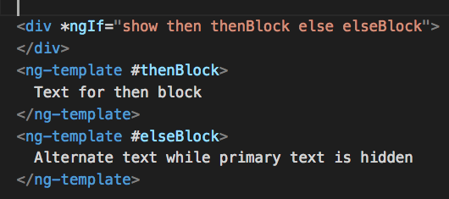
NgIf – then else
https://plnkr.co/edit/WclqVUR5VEFc2zG9IM0T

Slide 49
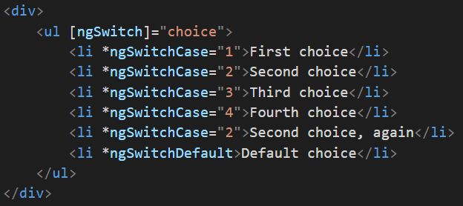
NgSwitch
ngSwitch allow a single evaluation of an expression and then display nested elements based on the value that resulted from that evaluation.
Describe the known results, using the ngSwitchCase directive
•Handle all the other unknown cases with ngSwitchDefault
Notes:
In the above example if the choice is 2 Second choice is displayed twice. Note that there is no default.

Slide 50

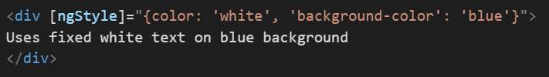
NgStyle
With the NgStyle directive, we can set a given DOM element CSS properties from Angular expressions.
[style.<cssproperty>]="value"
use the ngStyle attribute and use key value pairs for each property you want to set
Notes:
Note the quotes in the background-color. This is needed hence the key of the object should not contain -.

Slide 51
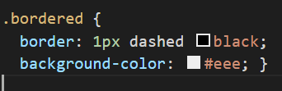

ngClass
The NgClass directive, represented by a ngClass attribute in your HTML template, allows to dynamically set and change the CSS classes for a given DOM element.
Notes:
Same as in Angular 1

Slide 52

ngFor
The syntax is *ngFor="let item of items".
The let item syntax specifies a (template) variable that’s receiving each element of the items array;
The items is the collection of items from your controller.
Notes:
Same as ngRepeat in Angular 1

Slide 53
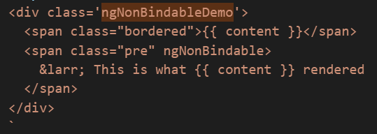
ngNonBindable
We use ngNonBindable when we want tell Angular not to compile or bind a particular section of our page.

Slide 54
Built-In Directive Demo
Demo
Notes:
Copy the different directives from Built-In Directives 01-03 to the HelloWorld Cli app that you developed and show the various directives.

Slide 55
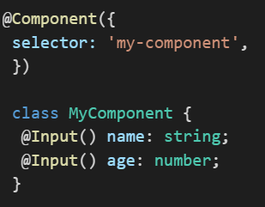
Component Inputs
Using @Input() annotation (import from @angular/Core)

Slide 56
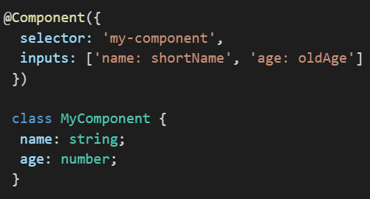
Component Inputs
Using @Input() annotation (import from @angular/Core)

Slide 57
Component Output
When you want to send data from your component to the outside world, you use output bindings
From button if the click event triggered , call the function in the component.
For all the existing html component’s events we can call the method in the component
<button (output)=“action()” />

Slide 58
Component Output – Emitting Custom Events
Create a component that emits the custom event
Specify outputs in the @Component configuration
Attach an EventEmitter to the output property
Emit an event from the EventEmitter, at the right time
Demo https://plnkr.co/edit/CyBD9Ms5j8plGEfTTIgT?p=info

Slide 59
Product Application
Product List
Product Row
Product Row
Product Row
Product Image
Product Department
Product Pricing
On selecting each product row display the product in the console
Demo

Slide 60
Product Application
Step 1: Create a new Angular Project using Angular Cli
Step 2: Top Down Approach. Create ProductList component.
Step 3: Pass products json object to the Product List
Step 3: Create Product.model.ts inline with the json object.
Step 5: Create components for Product Row, Product Image, Product Department, Product Display.

Slide 61
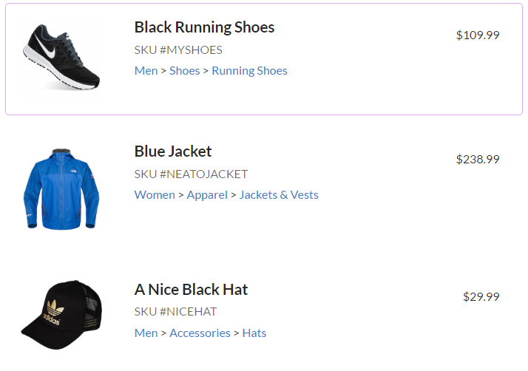
Product Application
Notes:
With the help of the handout create the application. The completed code is under demos- Product 01-03 for trainer’s reference.

Slide 62
Directives

Slide 63
Three kinds of Directives
Components
Directives from templates
Structural Directives
Change DOM layout by adding and removing elements
Attribute Directives
Change appearance or behavior of an element, component or another directive
Notes:
Components : What we have seen so far
Structural Directives: NgIf, NgFor
Attribute Directive: NgStyle

Slide 64


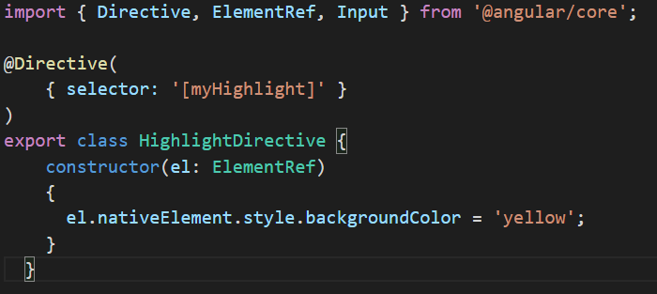
Build an attribute Directive
1
https://embed.plnkr.co/IongvT/
2
3
Injects so that the code can access the DOM element. In our case <p> (host element)
Import to fetch the directive and add that class in the declarations
requires a CSS selector to identify the HTML in the template that is associated with the directive
Notes:
@Directive requires a CSS selector to identify the HTML in the template that is associated with the directive. The CSS selector for an attribute is the attribute name in square brackets. Here, the directive's selector is [myHighlight]. Angular locates all elements in the template that have an attribute named myHighlight.
Naming conventions. Prefix with the business functionality and do not use Ng.

Slide 65
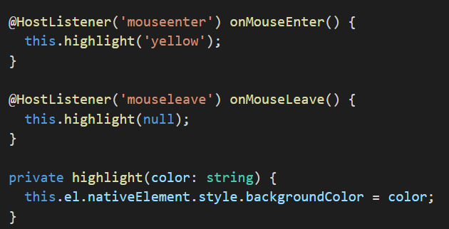
Respond to User Initiated Events
Imported from angular/core
https://embed.plnkr.co/e53m9b/

Slide 66
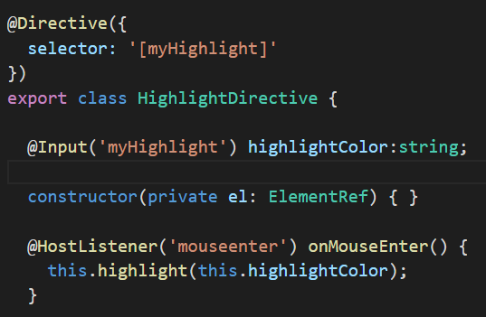
Pass values to the directive with @Input data binding
https://embed.plnkr.co/RKDFcn/
Should be same
Notes:
You can have many @Input and the values could be added in the html component without square brackets.

Slide 67
Dynamic Components
Notes:
Optional content

Slide 68
Dynamic Components
Component templates are not always fixed
Sometimes we may need to load the components at runtime
ComponentFactoryResolver is used to load the components at runtime

Slide 69
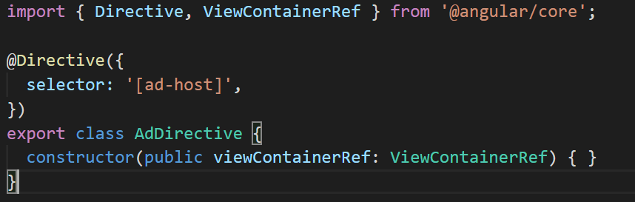
Dynamic Components
AnchorDirective
Define an anchor point to tell Angular where to insert the components
AdDirective injects ViewContainerRef to gain access to the view container of the element that will host the dynamically added component.

Slide 70
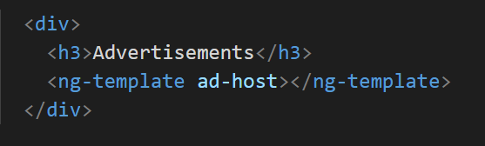
Dynamic Components
Loading the components
ng-template is a good choice since it doesn’t render anything

Slide 71
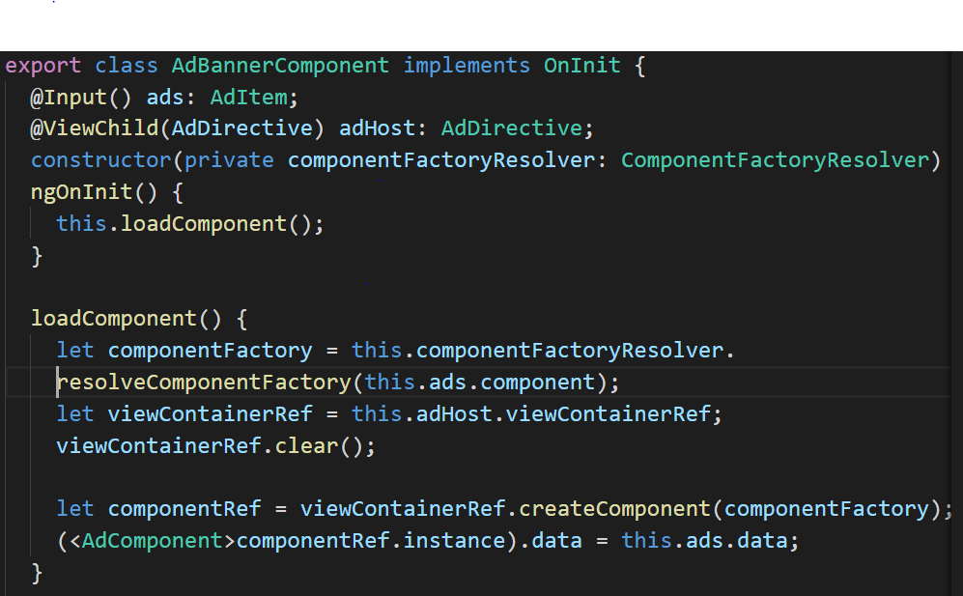
Dynamic Components
Resolving the components
AdDirective injects ViewContainerRef into its constructor. This is how the directive accesses the element that you want to use to host the dynamic component.
To add the component to the template, you call createComponent() on ViewContainerRef
The createComponent() method returns a reference to the loaded component.
Use that reference to interact with the component by assigning to its properties or calling its methods.

Slide 72
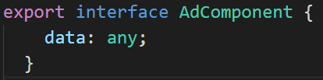
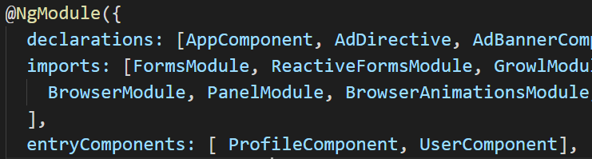
Dynamic Components
Create Dynamic components from an interface
Update in the @NgModule as entryComponents

Slide 73
DEMO

Slide 74
End of Day 1

